Slide 1
In-context learning over graphs

Slide 2
Overview
What is in-context learning?
In-context learning over graphs formulation
Pretraining Over Diverse In-Context Graph Systems (PRODIGY)

Slide 3
What is in-context learning?

Slide 4
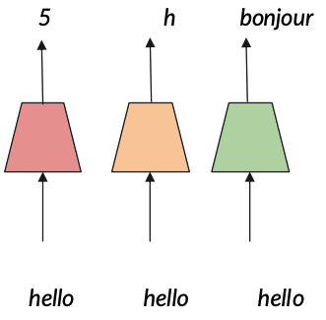
Machine learning paradigms
Traditional approach requires training a separate model for every task
Output
Model
Input
Image credit: Jure Leskovec, http://cs224w.stanford.edu

Slide 5
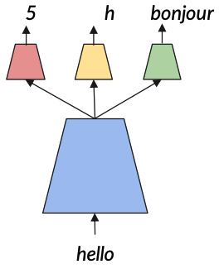
Machine learning paradigms
Finetuning (aka transfer learning) ”pre-trains” a model whose outputs are used in multiple downstream models that are individually trained. The pre-trained model may (or may not) be update during fine tuning.
Traditional approach requires training a separate model for every task
Output
Model
Input
Image credit: Jure Leskovec, http://cs224w.stanford.edu

Slide 6
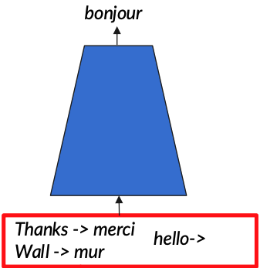
Machine learning paradigms
Finetuning (aka transfer learning) ”pre-trains” a model whose outputs are used in multiple downstream models that are individually trained. The pre-trained model may (or may not) be update during fine tuning.
Few-shot prompting provides examples (context) to a model (e.g., LLM) for a task on which it was not explicitly trained and asks for the output on a new input.
Traditional approach requires training a separate model for every task
Output
Model
Input
Image credit: Jure Leskovec, http://cs224w.stanford.edu

Slide 7
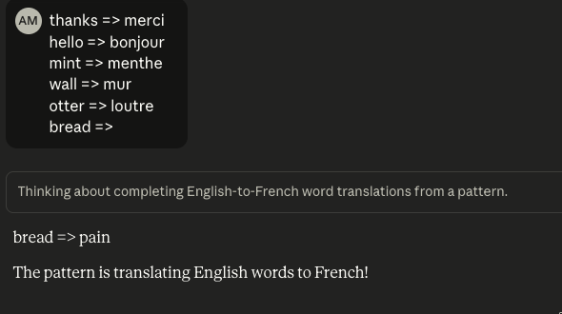
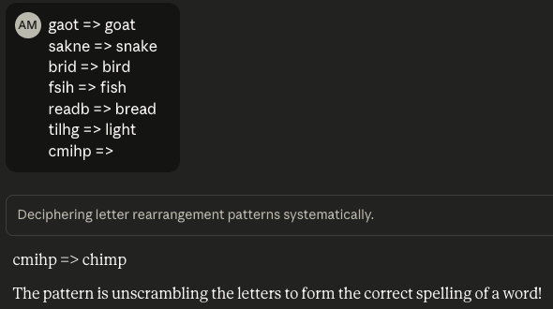
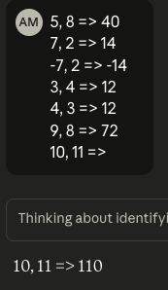
In-context learning with LLMs
Modern LLMs can perform in context learning given natural language prompts that demonstrate the problem to be solved

Slide 8
Machine learning paradigms on graphs
Finetuning (aka transfer learning) ”pre-trains” a model whose outputs are used in multiple downstream models that are individually trained. The pre-trained model may (or may not) be update during fine tuning.
Traditional approach requires training a separate model for every task
Output
Toxic
2
Metal
Toxic
2
Metal
Model
Node / edge encoder trained using graph properties for self-supervision. Decoder heads trained for each prediction task.
Input

Slide 9
In-context learning over graphs?
Output
How can we formulate and implement in-context learning over graphs?
Model
Input

Slide 10
Formulation

Slide 11
Graph learning tasks: node, edge inference
Node classification – given information about the node (may include neighbors, relationships, attributes), infer class membership (usually an attribute)
Edge prediction – given information about two nodes, determine if a given relation exists between them
Community detection (node clustering) – detection of “meaningful” node groups
Community Detection
Edge Prediction
?
A
B
Node Classification

Slide 12
Graph learning tasks: graph regression / classification
Whole graph classification and regression – given one entire graph, infer class membership or estimate (regress) a related numerical property
Inter graph tasks – given multiple graphs estimate the similarity between graphs and/or identify clusters
Classification
A
B
Regression
Y
G₁
G₂
Clustering
C₁ = {G₁, G₃, G₄}
C₂ = {G₂}
G₃
G₄

Slide 13
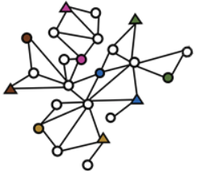
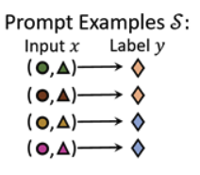
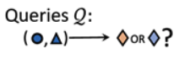
In-context learning over graphs?
An in-context learner for graphs should be able to solve new tasks without learning parameter updates!
Output
Model
Input
Different graphs
Different tasks
Image credit: Huang et all, 2023, NeurIPS

Slide 14
Challenges for in-context learning over graphs
How can the few-shot prompt for different graph tasks be represented in a single format to serve as model input?
How can a model be pre-trained to produce this emergent capability?

Slide 15
Challenges for in-context learning over graphs
How can the few-shot prompt for different graph tasks be represented in a single format to serve as model input?
Prompt Graph: represent each prompt example and query (task) with a meta hierarchical graph.
How can a model be pre-trained to produce this emergent capability?
PGPretraining: Pretrain a message passing model over self-supervised tasks in PromptGraph format with diverse underlying structures

Slide 16
Prompt Graph

Slide 17
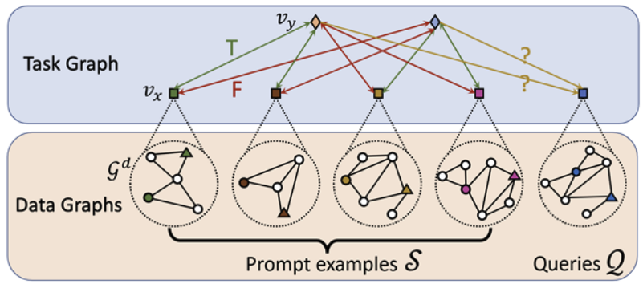
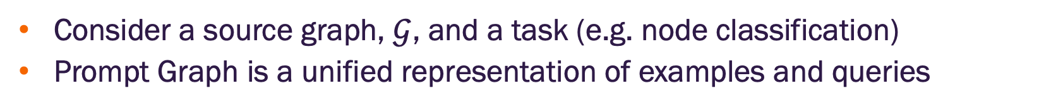
Prompt Graph overview
Consider a source graph, $𝒢$, and a task (e.g. node classification)
Prompt Graph is a unified representation of examples and queries
Image credit: Huang et all, 2023, NeurIPS

Slide 18
Prompt Graph overview
Prompt graph has two graphs
Data graphs
Task graph
Data Graphs (collection of graphs)
Examples (shots) that include local graph structure and labels that illustrate the task
Queries that include the local graph structure on which model inference is required
Task Graph
Includes a single data node for each data graph
Includes all possible outcome labels as nodes
Includes an edge between each data node and each label
T / F feature indicating if the label applies to the data node
Example / query feature indicating if the data node is from an example or a query
Image credit: Huang et all, 2023, NeurIPS

Slide 19
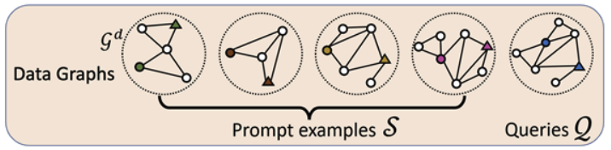
Connecting the data and task graphs
Second neural network applied to the task graph
Both graphs are trained together
Embeddings representing the data nodes
Single neural network applied to the data graphs to form the data node embedding
Image credit: Huang et all, 2023, NeurIPS

Slide 20
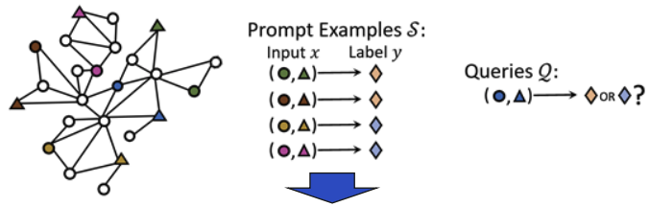
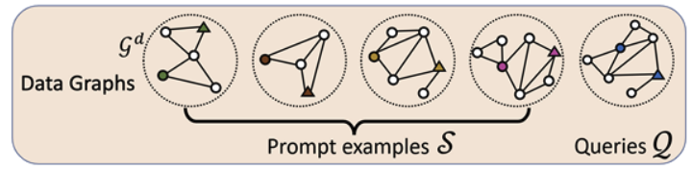
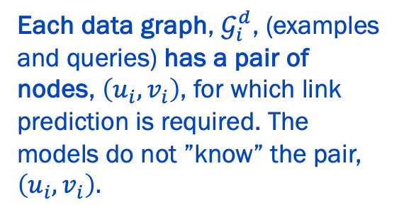
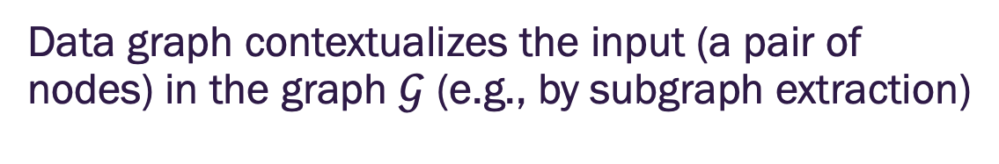
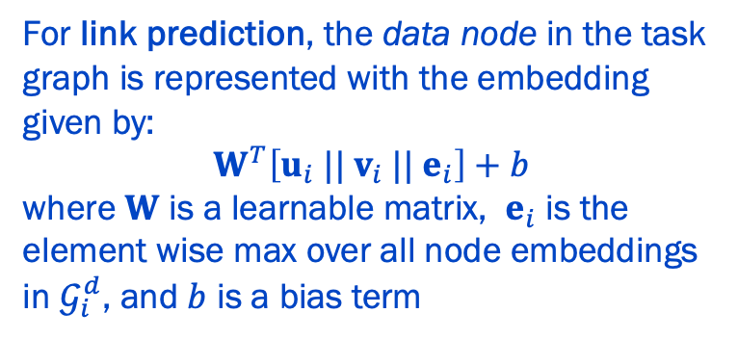
Data graph for link prediction
Data graph contextualizes the input (a pair of nodes) in the graph $𝒢$ (e.g., by subgraph extraction)
Each data graph, $𝒢_{i}^{d}$, (examples and queries) has a pair of nodes, $\left(u_{i},v_{i}\right)$, for which link prediction is required. The models do not ”know” the pair, $\left(u_{i},v_{i}\right).$
For link prediction, the data node in the task graph is represented with the embedding given by:
$$W^{T}\left[u_{i}{ || v}_{i}{ || e}_{i}\right]+b$$
where $W$ is a learnable matrix, $e_{i}$ is the element wise max over all node embeddings in $𝒢_{i}^{d}$, and $b$ is a bias term
Image credit: Huang et all, 2023, NeurIPS

Slide 21
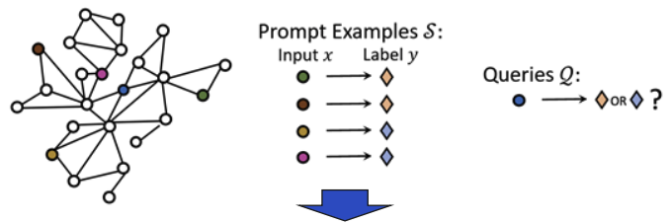
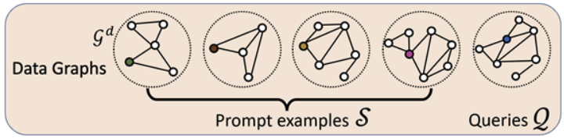
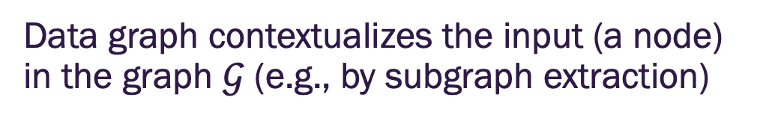
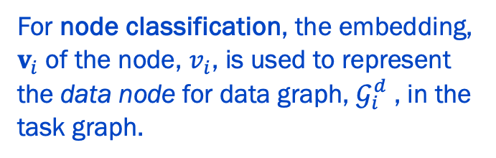
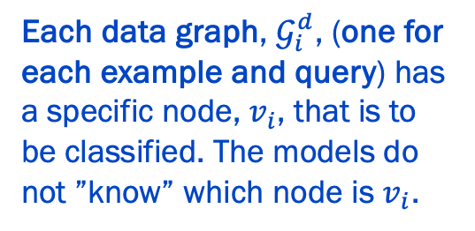
Data graph for node classification
Data graph contextualizes the input (a node) in the graph $𝒢$ (e.g., by subgraph extraction)
Each data graph, $𝒢_{i}^{d}$, (one for each example and query) has a specific node, $v_{i}$, that is to be classified. The models do not ”know” which node is $v_{i}$.
For node classification, the embedding, $v_{i}$ of the node, $v_{i}$, is used to represent the data node for data graph, $𝒢_{i}^{d}$, in the task graph.
Image credit: Huang et all, 2023, NeurIPS

Slide 22
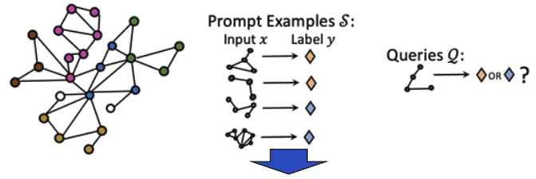
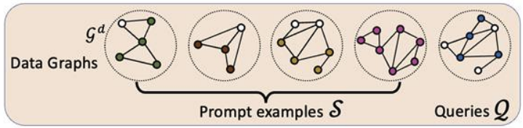
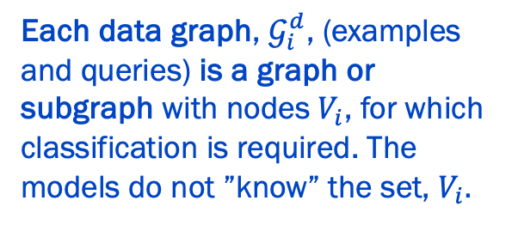
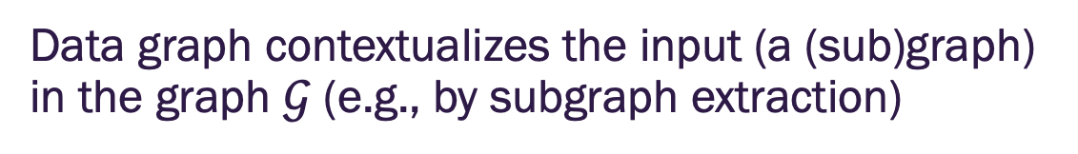
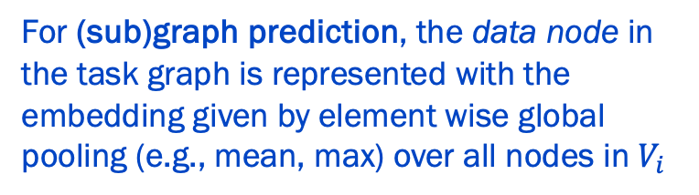
Data graph for (sub)graph classification
Data graph contextualizes the input (a (sub)graph) in the graph $𝒢$ (e.g., by subgraph extraction)
Each data graph, $𝒢_{i}^{d}$, (examples and queries) is a graph or subgraph with nodes $V_{i}$, for which classification is required. The models do not ”know” the set, $V_{i}.$
For (sub)graph prediction, the data node in the task graph is represented with the embedding given by element wise global pooling (e.g., mean, max) over all nodes in $V_{i}$
Image credit: Huang et all, 2023, NeurIPS

Slide 23
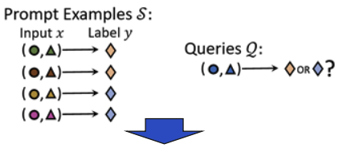
Task graph for link prediction
Task graph interconnects inputs and labels across examples to form context for queries
How do we construct the task graph given the input samples and queries?
Image credit: Huang et all, 2023, NeurIPS

Slide 24
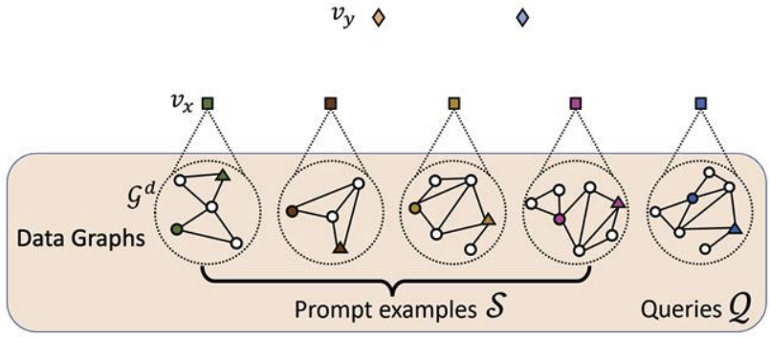
Task graph for link prediction
Task graph interconnects inputs and labels across examples to form context for queries
Label nodes with embeddings that have random Gaussian initialization
Data nodes with embeddings generated from the network applied to each data graph
Image credit: Huang et all, 2023, NeurIPS

Slide 25
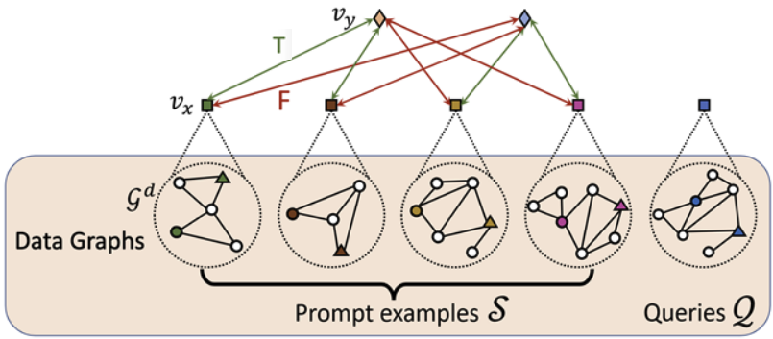
Task graph for link prediction
Task graph interconnects inputs and labels across examples to form context for queries
Prompt examples: Bidirectional edges added between data nodes and label nodes.
Image credit: Huang et all, 2023, NeurIPS

Slide 26
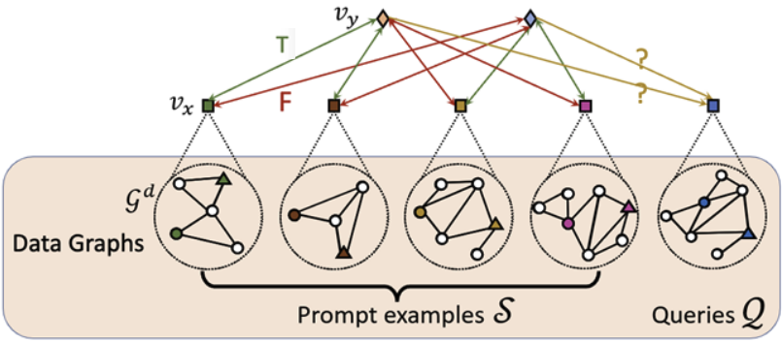
Task graph for link prediction
Task graph interconnects inputs and labels across examples to form context for queries
Queries: Directed edge from each label node to each data node
Prompt examples: Bidirectional edges added between data nodes and label nodes.
Image credit: Huang et all, 2023, NeurIPS

Slide 27
Task graph for link prediction
Task graph interconnects inputs and labels across examples to form context for queries
Queries: Directed edge from each label node to each data node
Prompt examples: Bidirectional edges added between data nodes and label nodes.
Edge features
T / F feature indicating if the label applies to the data node (set to F for all query nodes)
Example / query feature indicating if the data node is from an example or a query
Image credit: Huang et all, 2023, NeurIPS

Slide 28
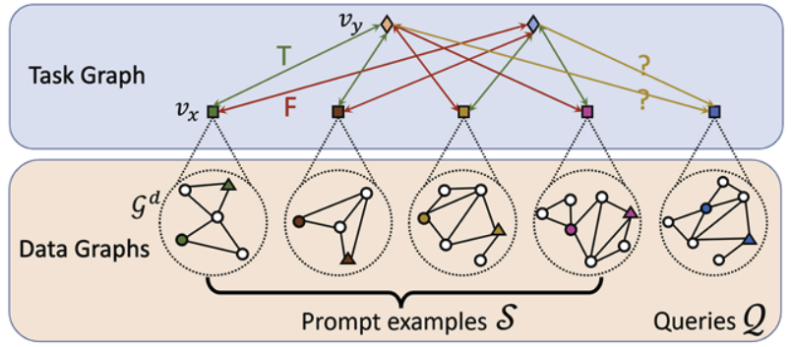
Task graph for link prediction
Task graph interconnects inputs and labels across examples to form context for queries
Image credit: Huang et all, 2023, NeurIPS

Slide 29
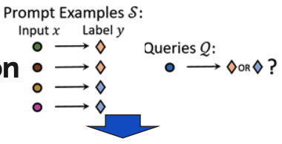
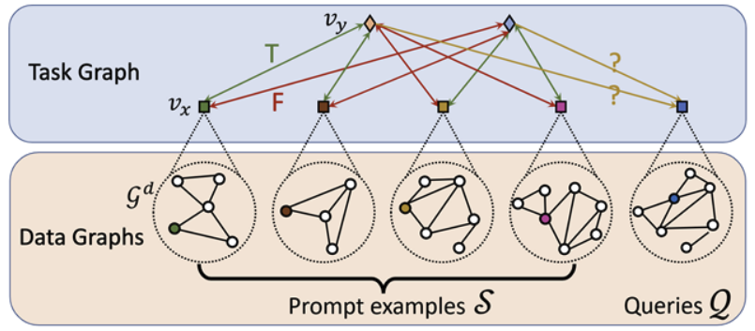
Task graph for node classification
Task graph interconnects inputs and labels across examples to form context for queries
Same as link predictions except that the data nodes are node-level embeddings from the data graphs
Image credit: Huang et all, 2023, NeurIPS

Slide 30
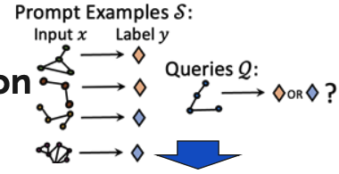
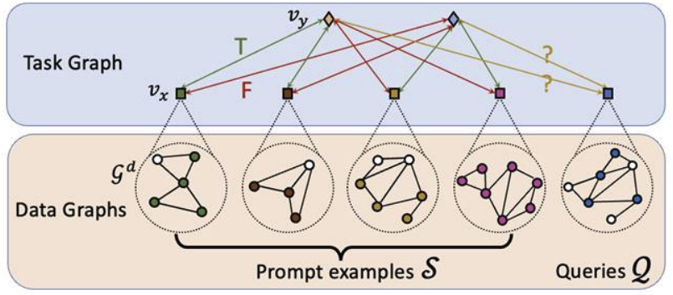
Task graph for (sub)graph classification
Task graph interconnects inputs and labels across examples to form context for queries
Same as link predictions except that the data nodes are graph-level embeddings from the data graphs
Image credit: Huang et all, 2023, NeurIPS

Slide 31
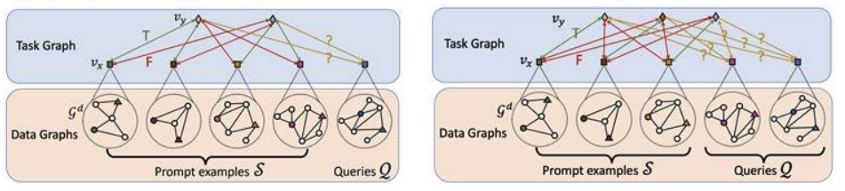
Task graph flexibility
Task graph unifies classification task formulation
Different numbers of classes are represented as different number of label nodes
Different number of prompt examples (shots) and queries are represented as different number of data nodes
2-shots prompt for 2-class classification (Each “shot” includes a sample for each class label)
1-shot prompt for c-class classification (Each “shot” includes a sample for each class label)

Slide 32
Prompt graph inference

Slide 33
In-context inference (prediction)
Second neural network applied to the task graph
How should we design these networks? With GNNs of course!
Single neural network applied to the data graphs to form the data node embedding
Image credit: Huang et all, 2023, NeurIPS

Slide 34
In-context inference (prediction)
Perform hierarchical message passing over the Prompt Graph
Image credit: Huang et all, 2023, NeurIPS

Slide 35
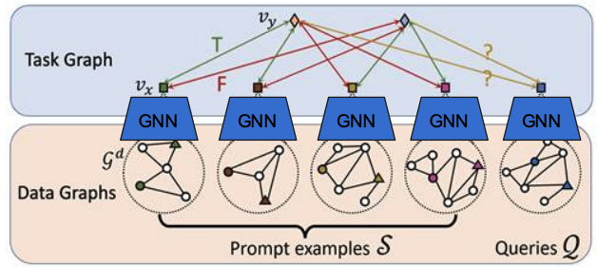
In-context inference (prediction)
Perform hierarchical message passing over the Prompt Graph
GNN over data graphs (e.g., GCN, GAT) – same GNN processes each data graph separately to produce data node embeddings
Image credit: Huang et all, 2023, NeurIPS

Slide 36
In-context inference (prediction)
Perform hierarchical message passing over the Prompt Graph
GNN over data graphs (e.g., GCN, GAT) – same GNN processes each data graph separately to produce data node embeddings
GNN with attention over task graph - produces updated embeddings for labels and data nodes
GNN with attention
Image credit: Huang et all, 2023, NeurIPS

Slide 37
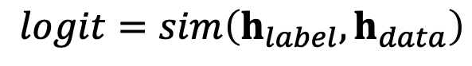
In-context inference (prediction)
Perform hierarchical message passing over the Prompt Graph
GNN over data graphs (e.g., GCN, GAT) – same GNN processes each data graph separately to produce data node embeddings
GNN with attention over task graph – produces updated embeddings for labels and data nodes
Compute the logits
$$logit=sim\left(h_{label},h_{data}\right)$$
GNN with attention
Image credit: Huang et all, 2023, NeurIPS

Slide 38
PRODIGY pretraining

Slide 39
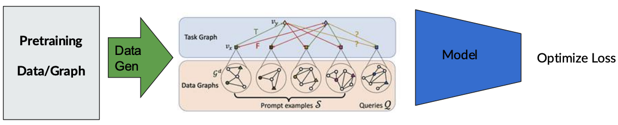
In-context pretraining
Goal is to create training examples represented in the Prompt Graph format that serve as a model pretraining dataset
Image credit: Huang et all, 2023, NeurIPS

Slide 40
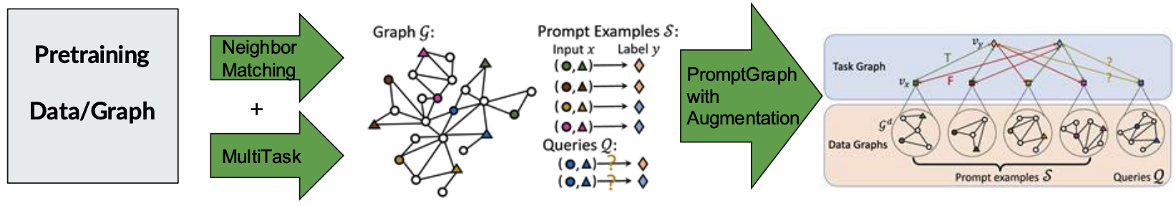
In-context pretraining data generation
Few shot prompt generation
Image credit: Huang et all, 2023, NeurIPS

Slide 41
In-context pretraining data generation
Few shot prompt generation
Supervised training on multiple tasks if labeled data is available
Image credit: Huang et all, 2023, NeurIPS

Slide 42
In-context pretraining data generation
Few shot prompt generation
Supervised training on multiple tasks if labeled data is available
Self-supervised prompts on neighbor matching task
How does this work?
Image credit: Huang et all, 2023, NeurIPS

Slide 43
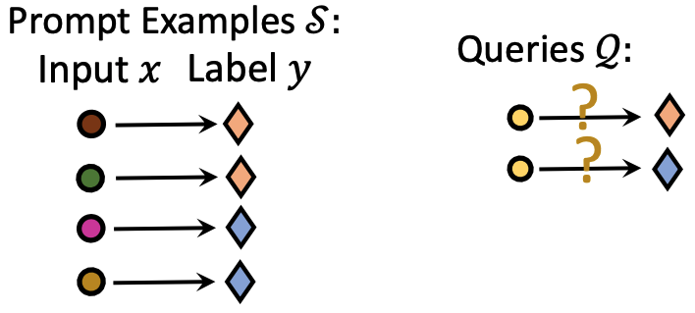
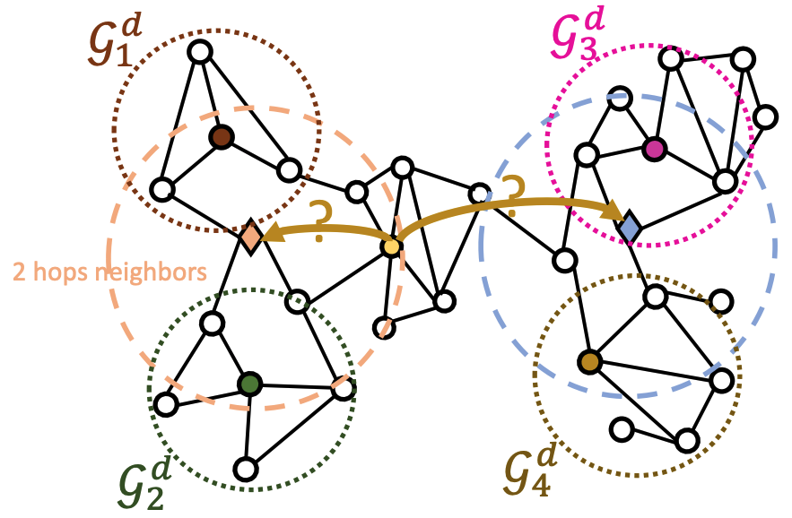
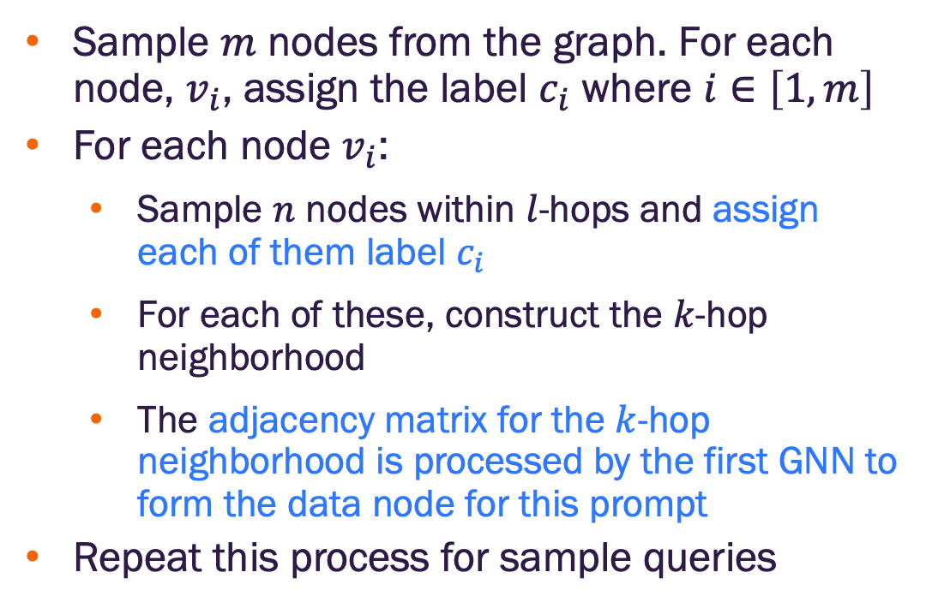
Neighborhood matching for pretraining
The task is to classify which neighborhood a node is in based on local structure (i.e., nodes within $l$-hops)
Sample $m$ nodes from the graph. For each node, $v_{i}$, assign the label $c_{i}$ where $i∈\left[1,m\right]$
For each node $v_{i}$:
Sample $n$ nodes within $l$-hops and assign each of them label $c_{i}$
For each of these, construct the $k$-hop neighborhood
The adjacency matrix for the $k$-hop neighborhood is processed by the first GNN to form the data node for this prompt
Repeat this process for sample queries
Image credit: Huang et all, 2023, NeurIPS

Slide 44
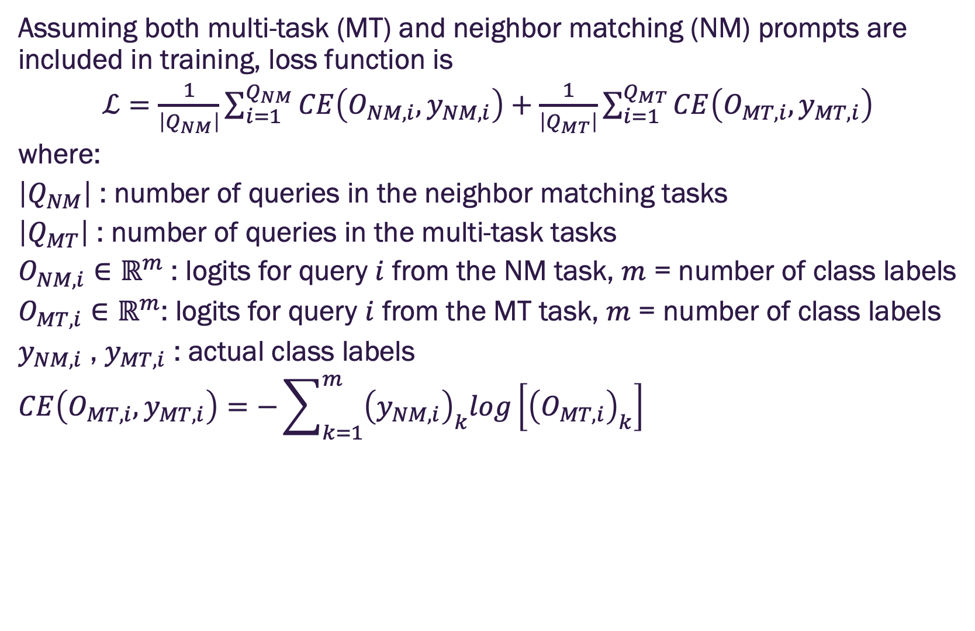
Pretraining loss function
Assuming both multi-task (MT) and neighbor matching (NM) prompts are included in training, loss function is
$ℒ=\frac{1}{\left|Q_{NM}\right|}\sum_{i=1}^{Q_{NM}}{CE\left(O_{NM,i},y_{NM,i}\right)+\frac{1}{\left|Q_{MT}\right|}\sum_{i=1}^{Q_{MT}}{CE\left(O_{MT,i},y_{MT,i}\right)}}$
where:
$\left|Q_{NM}\right|$ : number of queries in the neighbor matching tasks
$\left|Q_{MT}\right|$ : number of queries in the multi-task tasks
$O_{NM,i}∈ℝ^{m}$ : logits for query $i$ from the NM task, $m$ = number of class labels
$O_{MT,i}∈ℝ^{m}$: logits for query $i$ from the MT task, $m$ = number of class labels
$y_{NM,i}$ , $y_{MT,i}$ : actual class labels
$$CE\left(O_{MT,i},y_{MT,i}\right)=−\sum_{k=1}^{m}{{\left(y_{NM,i}\right)}_{k}log\left[{\left(O_{MT,i}\right)}_{k}\right]}$$

Slide 45
An implementation note
As formulated, the data graphs are processed by a GNN
Implies feature vectors are required for the nodes
Original method limited features to text descriptions which were first processed by a language model to form an embedding
Recent work has considered other task domains with consistent, but non-text features

Slide 46
Summary
In-context learning models do not require additional parameter updates to perform new tasks
Prompt Graph provides one possible formulation for representing few-shot prompts on graphs for diverse tasks
Pretraining with neighborhood matching and multi-task learning enables few-shot learning
Active area of research

Slide 47


